Slide 1

Fire Safety Tips

Slide 2
Overview for Presenters:
Fire is Everyone’s Fight Community PowerPoint Presentation
This PowerPoint includes slides to cover the essential home fire safety information for any community presentation.
In addition, audience-specific slides have been created for:
  Caregivers of babies and toddlers.
  Older adults.
  Caregivers of older adults.
Use these additional slides as needed to customize your presentation to your audience.
Optional audience-specific slides can also be deleted as a group if
not needed.

Slide 3
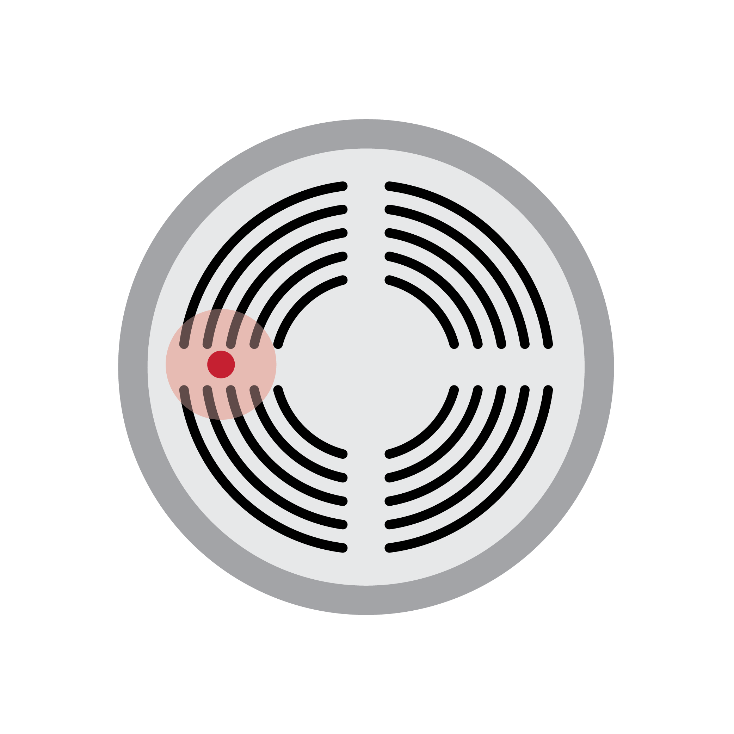
Fire is fast!
You may have less the 3 minutes to escape.
Smoke is deadly — kills more people than flames.
Every home needs fire protection and a plan for escape.

Slide 4
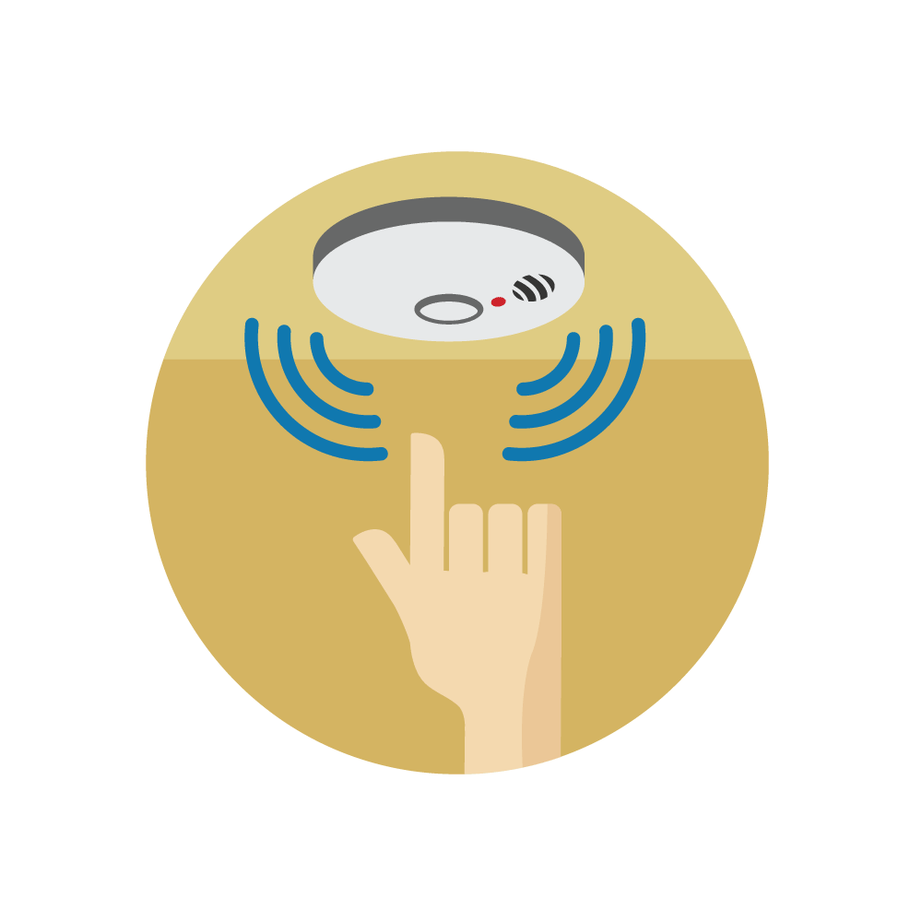
Smoke alarms save lives.
Have working smoke alarms on every level of your home.
You should have a smoke alarm inside bedrooms and outside sleeping areas.
Push the button on the smoke alarms every month to make sure they are working.
Replace smoke alarms that are more than 10 years old.

Slide 5
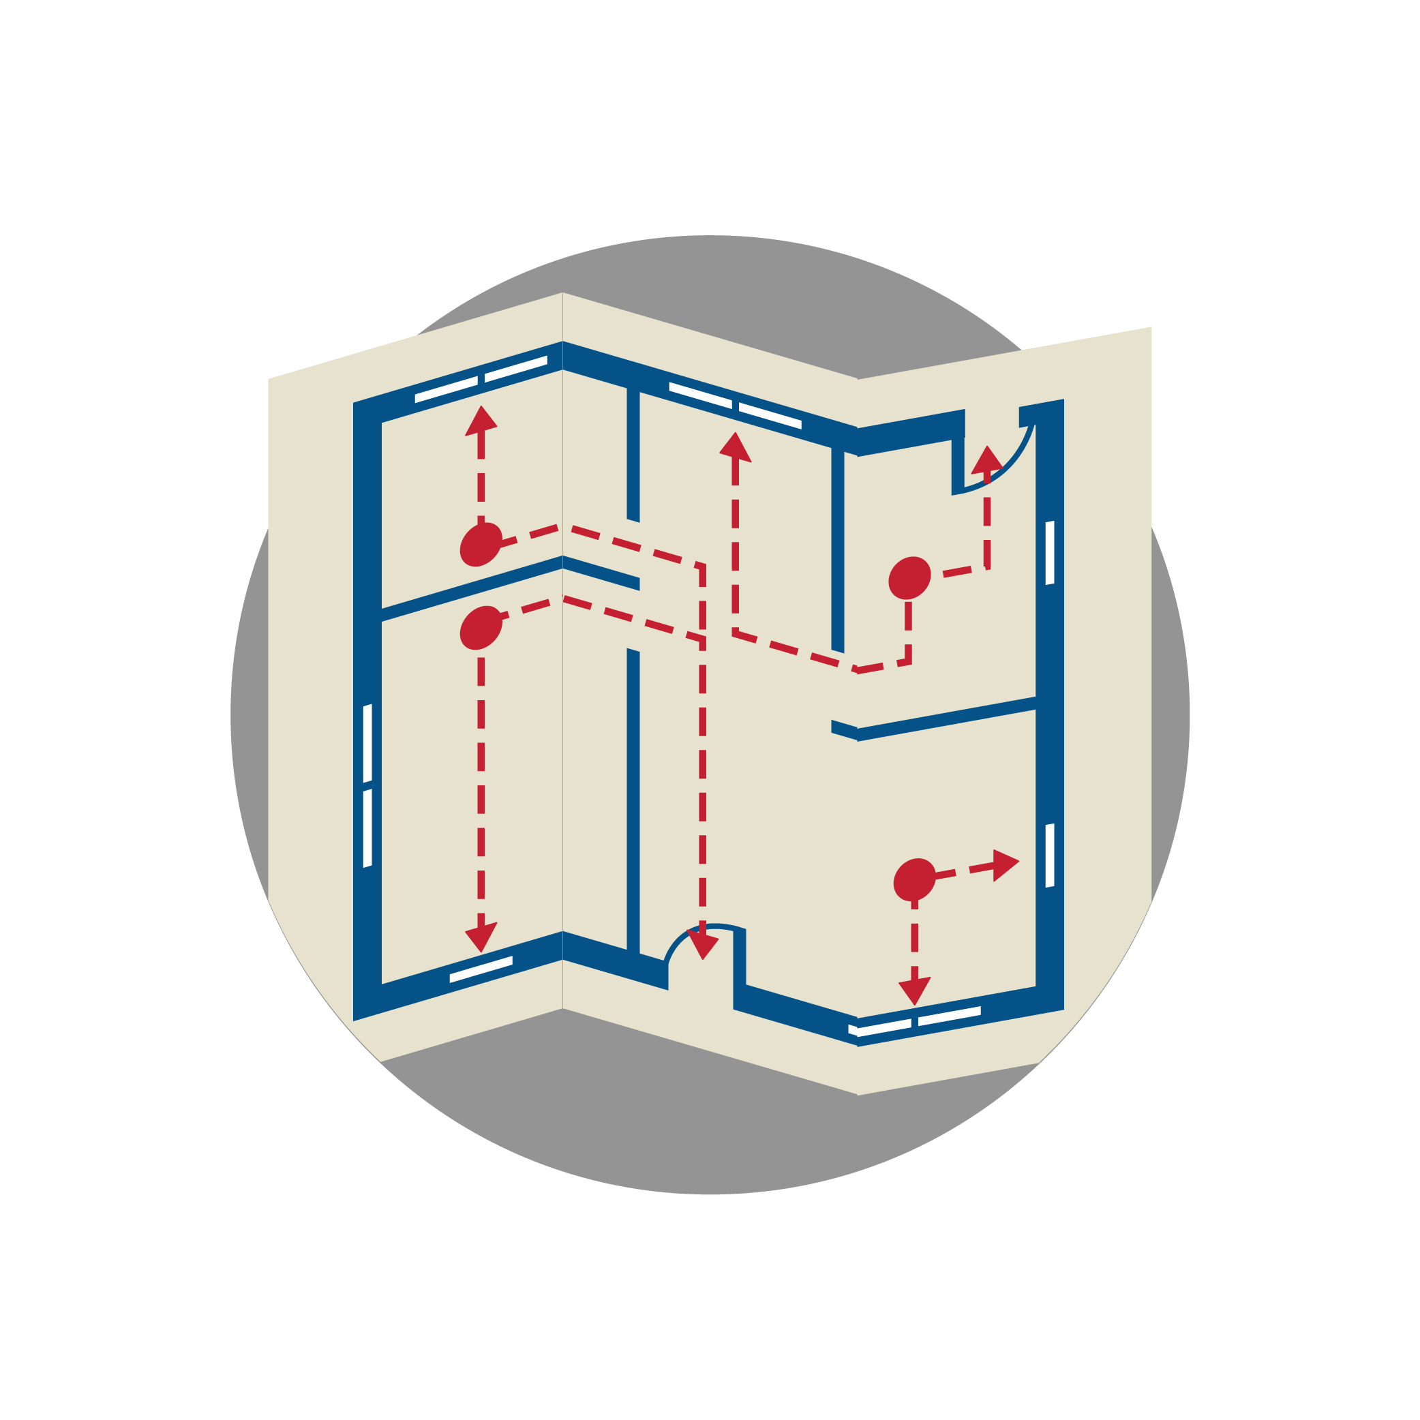
Make an escape plan.
Know 2 ways out of every room.
Have a meeting place outside
your home.
Know how to call 9-1-1 from outside to report a fire.
Practice your escape plan with everyone who lives in your home at least twice a year.

Slide 6
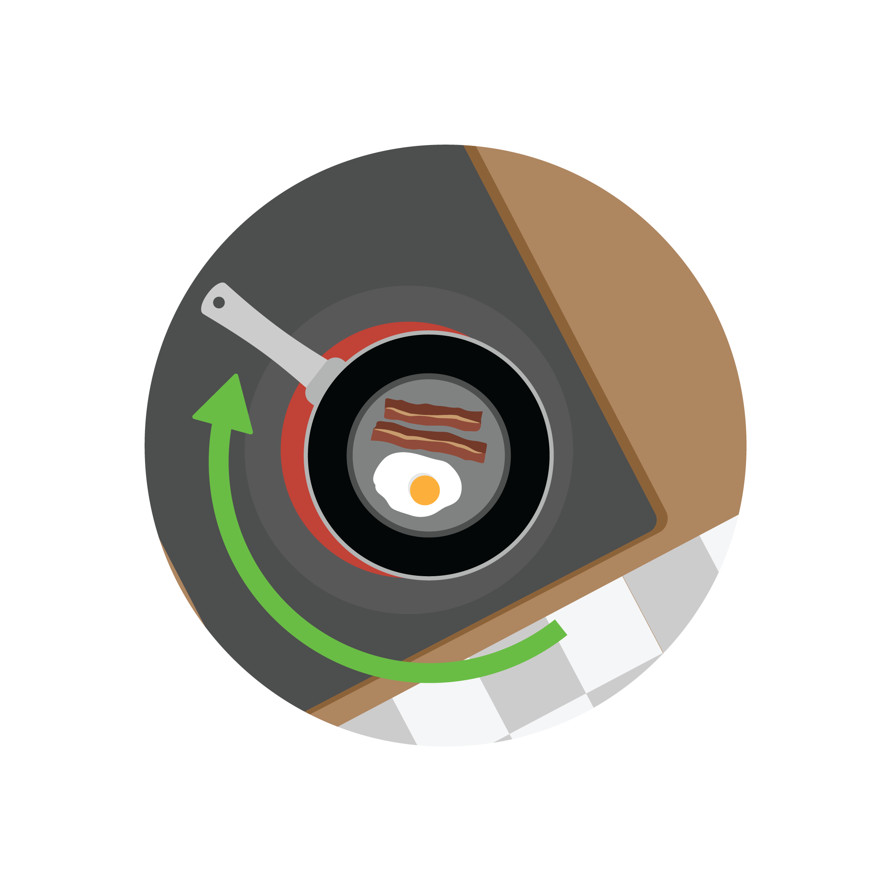
Cooking is the number one cause of home fires.
Stay in the kitchen when you are frying, grilling, broiling, or boiling food.
If you leave the kitchen, turn the burner off.
Keep things that can burn away from your cooking area.
Turn pot handles toward the back of the stove so they won’t get bumped.

Slide 7
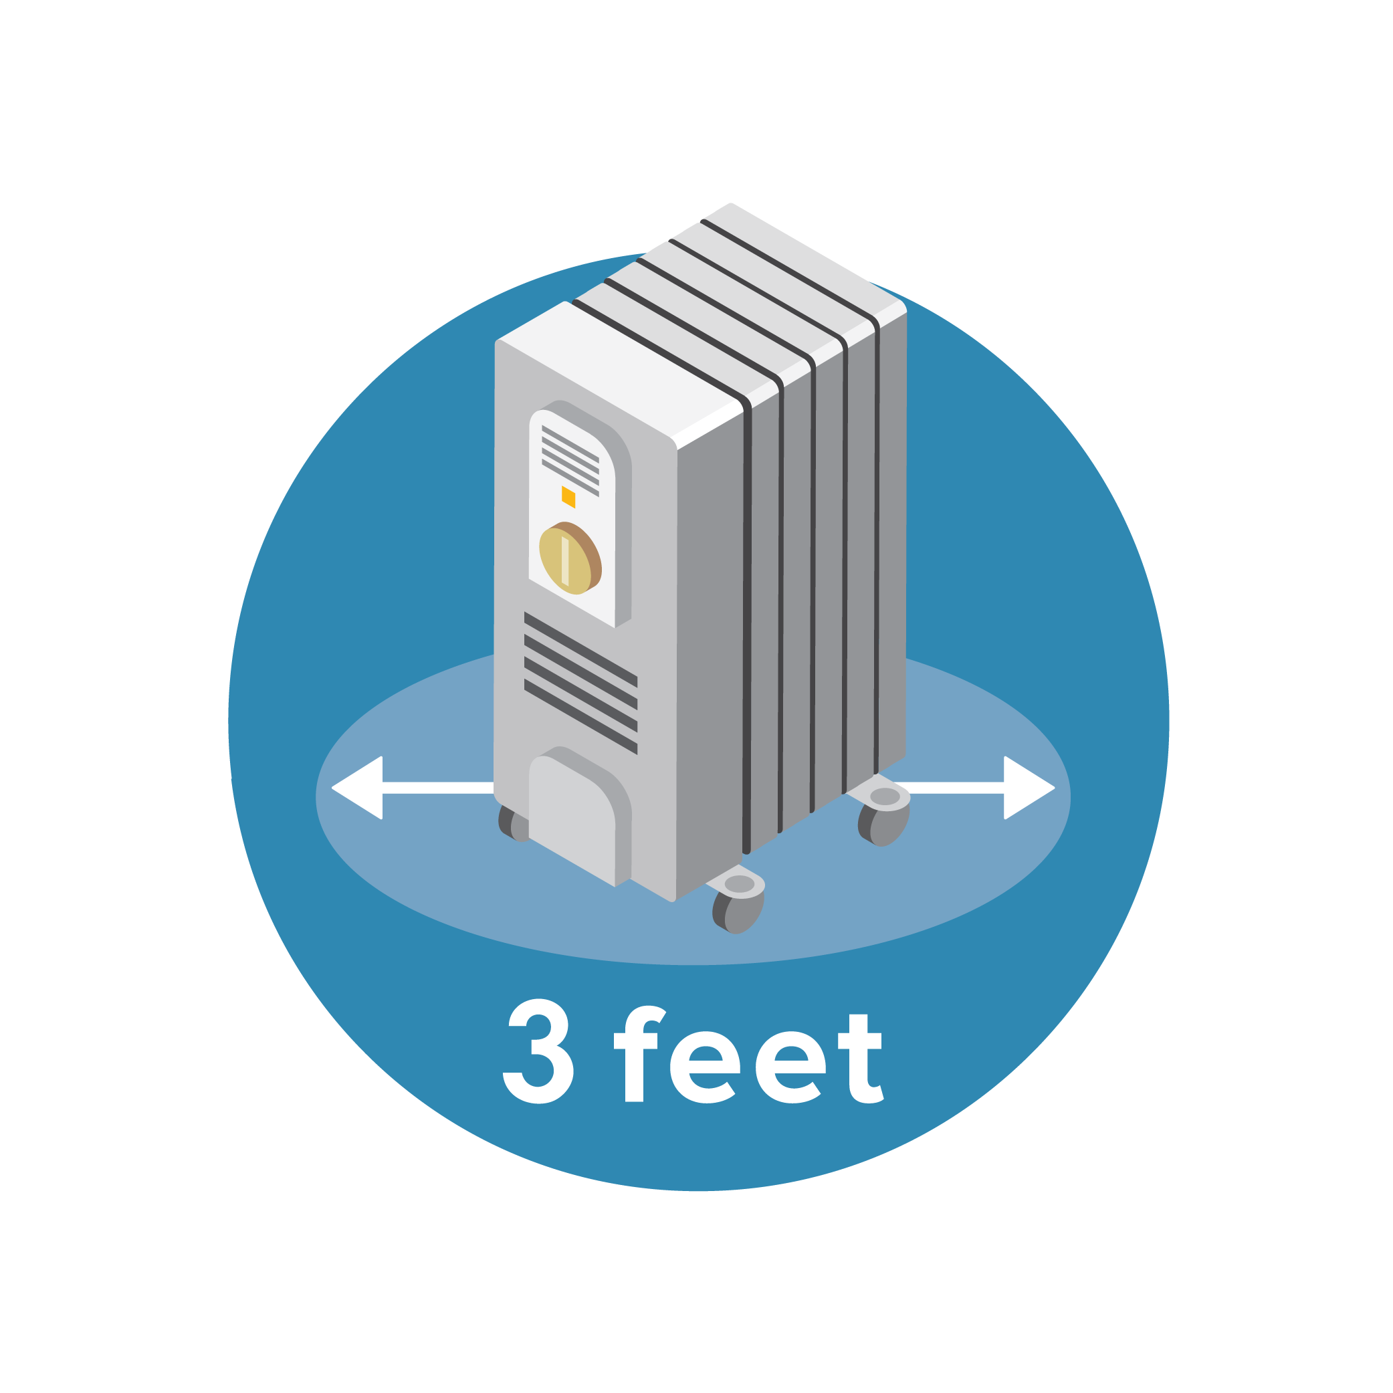
Heating is the second leading cause of home fires.
Keep anything that can burn at least three feet away from fireplaces, wood stoves, portable heaters, and radiators.
When you leave a room or go to bed, turn heaters off or unplug them.

Slide 8
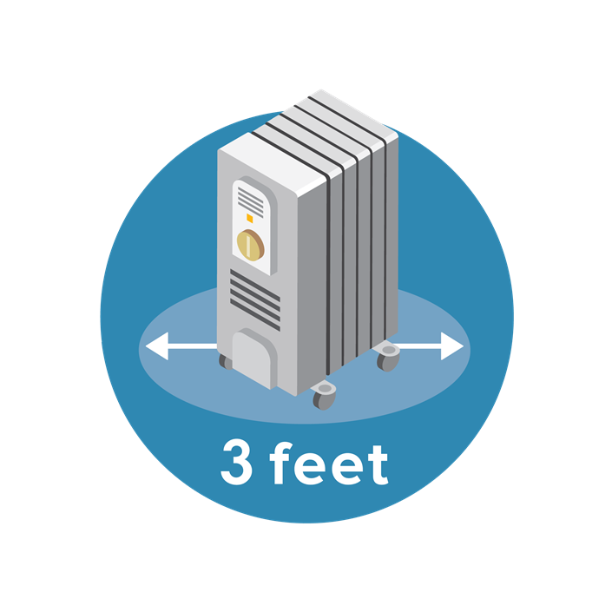
Heating is the second leading cause of home fires.
(cont’d)
Have your furnace, chimney, and chimney connector inspected by a professional each winter.
  Make repairs before cool weather sets in.
Make sure your portable heater has an automatic shut-off switch that turns it off if it tips over.

Slide 9

Be fire smart with electricity.
Extension cords are for temporary use only.
If you have an electrical cord that is frayed or broken, don’t use it.

Slide 10
Be fire smart with electricity. (cont’d)
Plug portable heaters directly into the outlet.
  Don’t use an extension cord.
Plug only one heat-producing appliance into the electrical outlet.
  Never use an extension cord.
  Examples: microwave, coffee maker, and portable heater.

Slide 11

Smoking in your home puts you at higher risk to have a fire.
Ask all smokers to:
Always smoke outside.
Use deep, sturdy ashtrays.
Put cigarettes all the way out — every time.
Put water on cigarette butts before throwing them in the trash.
Never smoke in bed or if drowsy.

Slide 12

Caregivers of Babies and Toddlers

Slide 13
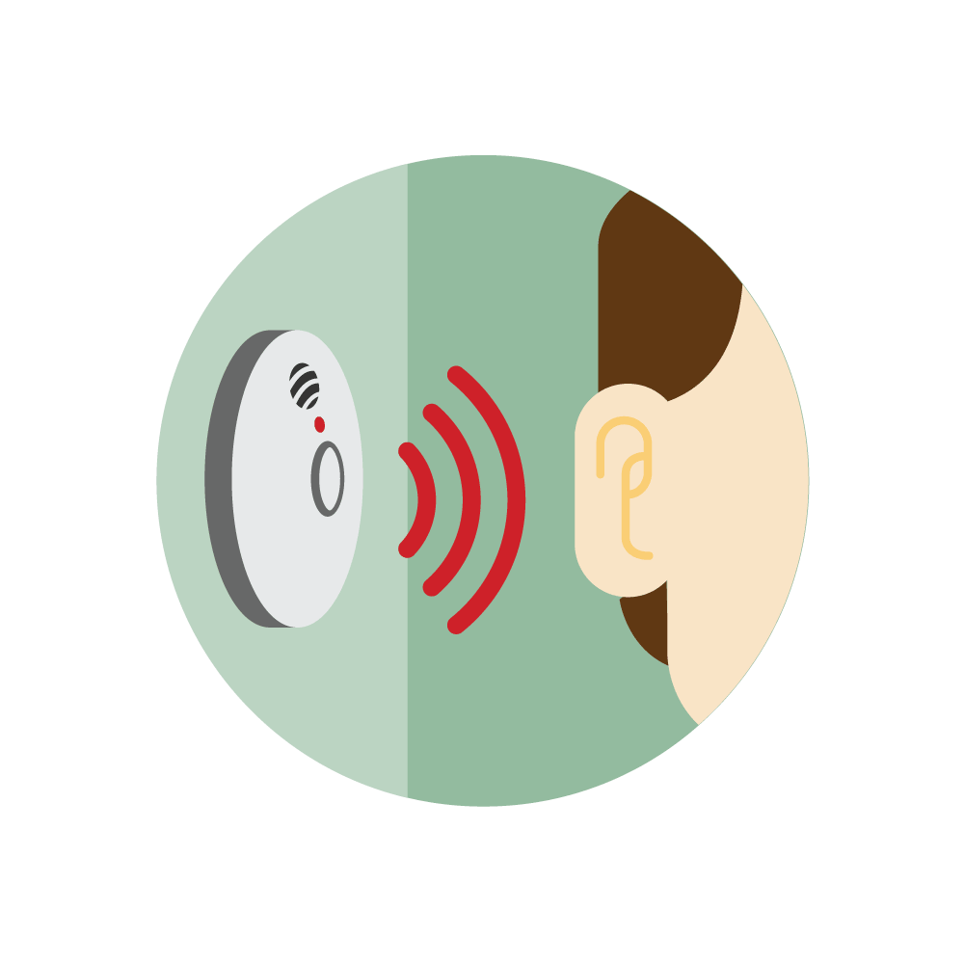
Children under the age of four are at a higher risk of home fire injury and death than older children.
Most child deaths are in homes without working smoke alarms.
Teach all children what the smoke alarm sounds like.
Be aware that children may sleep through the sound of the smoke alarm.

Slide 14
Practice your escape plan with children.
Have a plan for young children who cannot get outside by themselves.
You will need to wake babies and very young children and help them get out.
Teach older children how to get outside if there is a fire.

Slide 15
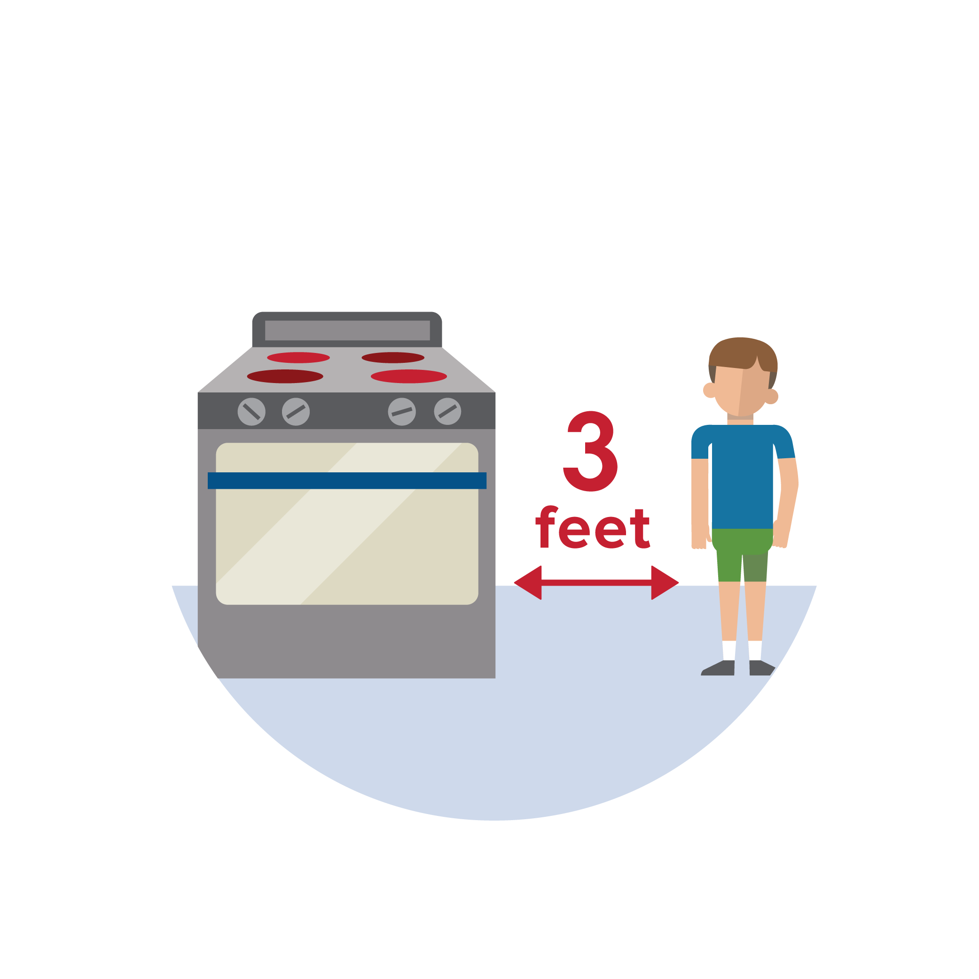
Keep children safe from fire danger.
Keep children 3 feet away from anything that can get hot.
  Space heaters and stovetops can cause terrible burns.
Lock up any items that can start a fire (matches, lighters, cigarettes, etc.).
Make sure children cannot reach candles.

Slide 16

Older Adults

Slide 17
Prevent a fire from starting.
Medical oxygen can explode if a flame or spark is nearby.
  Even if the oxygen is turned off, it can still catch on fire.
Keep heaters at least 3 feet away from things that can burn.

Slide 18
Prevent a fire from starting.
(cont’d)
Heaters can cause fires if they are too close to furniture, beds, curtains, or other materials that can burn.
Turn space heaters off before you leave the home.

Slide 19
Be sure your smoke alarms work for you!
You can test your smoke alarm using a cane or broom handle.
Test to make sure the sound of the alarm is loud enough to wake you.
  Vibration/strobe smoke alarms are available.

Slide 20
Make an escape plan around your abilities.
If you need to use a wheelchair or cane, make sure you can get to them quickly.
Keep wheelchair/cane, glasses, or hearing aids next to the bed.

Slide 21
Be aware of fire risks when drowsy.
Be a safe cook. Make sure you are awake and alert when cooking.
  Alcohol and some drugs can make you sleepy.
Smoke only when alert.
  Never smoke in bed or if drowsy.
Blow out all candles if you leave the room, get sleepy, or go to bed.

Slide 22
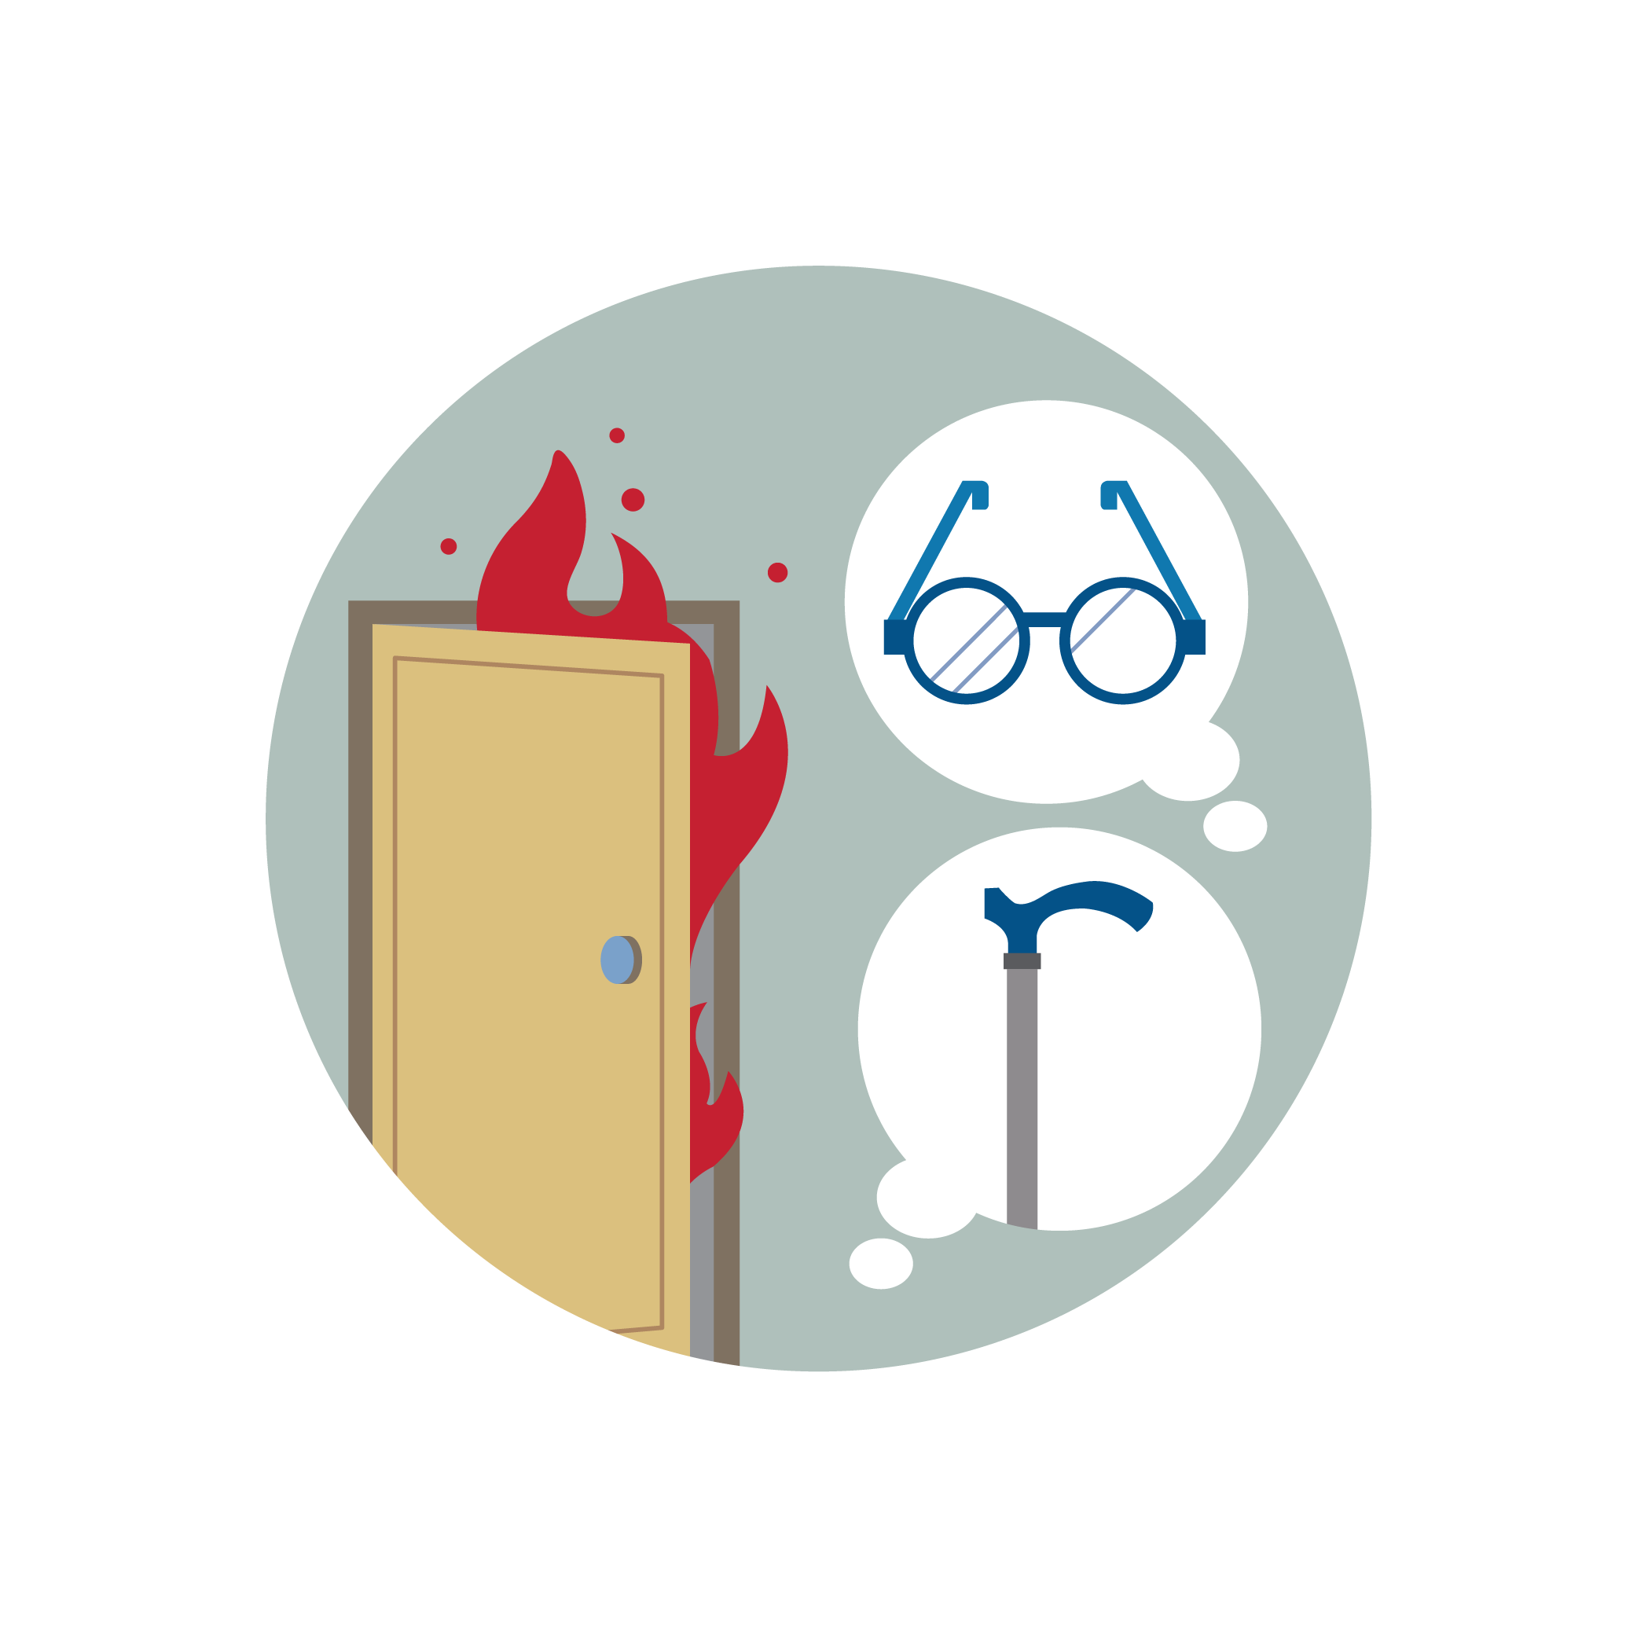
Caregivers of
Older Adults

Slide 23

Help an older adult stay safe at home.
Make sure the smoke alarms work and that they will wake people up when they are sleeping.
  Vibration/strobe smoke alarms are available.
Test smoke alarms once a month.
Replace smoke alarms after 10 years.

Slide 24
Make an escape plan around their abilities.
Make a fire escape plan that tells what each person will need to do to get out safely.
Remind the older adults to keep a phone, wheelchair/cane, hearing aid, and glasses next to their bed.

Slide 25
Help prevent fires from starting.
Make sure no one smokes in bed or around medical oxygen.
Keep 3 feet between heaters and materials that can catch fire.

